Slide 1
Pentaho Big Data Integration & Analytics
Marcos Andersen
Sales, Latin America
October, 2016
Notes:
This is not a technical or Pentaho product presentation
It essentially covers some Big Data blue prints and how Pentaho is helping customers to get value and insights through Big Data architectures
ES Esto no es una presentación técnica de Pentaho.
Es una apresentacion sobre Blueprints de Big Data y cómo Pentaho está ayudando a los clientes obtener valor y insights a través de arquitecturas Big Data

Slide 2
Pentaho Corporation
Company Overview
Company
US company (12 years)
San Francisco, CA & Orlando, FL
Acquired by Hitachi
Highlights
WW leader Open Source Business Analytics & Data Integration
20,000+ implementations / 1,800+ customers
Suite

Slide 3
HITACHI Limited
Founded in 1910
US$96.1B FY12
1000 subsidiaries
326,000 employees
Thousands of PhDs
us$3.6B
INNOVATION BUDGET
#54 in the 2013 FORTUNE® Global 500

Slide 4




Internet of Things in 2020
152M connected cars (IHS Automotive)
1.1B smart meters installed (Navigant Research)
200B connected objects (Intel)
$19T economic value created by Internet of
Things (Cisco)
$2.5T annual impact of IoT in healthcare (by 2025, McKinsey)
>90% IoT data to be hosted on cloud platforms (IDC)
Notes:
These are just a few data points showing the scale of “things”
The impact that IoT will have
And the importance of cloud platforms in addressing IoT needs

Slide 5

The Opportunity in 2020
Internet of Things
Social Innovation
$7.1 trillion
$2 trillion
Notes:
The total market size for IoT is predicted to be over $7 trillion by 2020
And, given the industries that we play in and the products and solutions that we build, we estimate our addressable market to be $2 trillion
As a commercial enterprise, that market opportunity certainly gets our attention
But more importantly, we see this as a measure of the enormous impact that we can make by investing in our IoT business and bringing real solutions to market that make a difference
We feel that this is more than an opportunity; it’s an obligation that we have

Slide 6






































Pentaho WW

Slide 7















































Pentaho LATAM

Slide 8
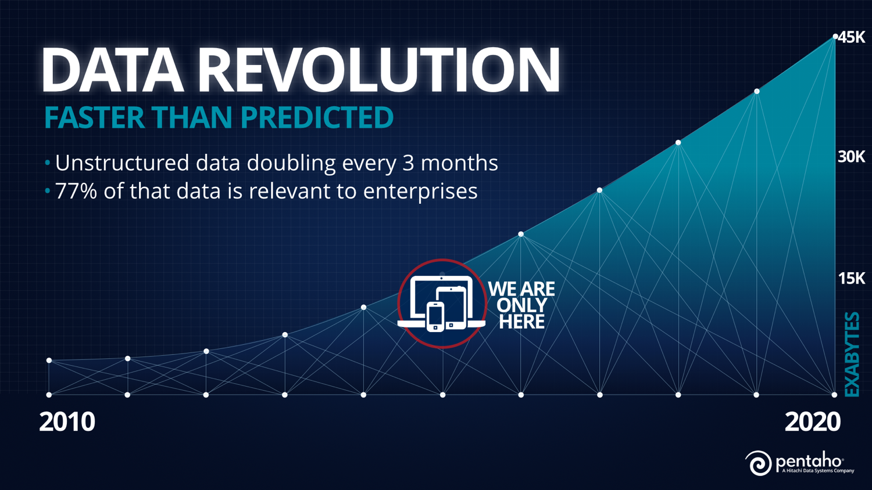
Notes:
SLIDE 1- (beginning of data revolution graphic)
+LAST YEAR’S PW ALL ABOUT THE DATA- UNIVERSE OF DATA IS EXPLODING- DATA DOUBLING EVERY YEAR- UNSTRUCTURED DATA DOUBLING EVERY 3 MONTHS—77% OF THAT DATA IS DEEMED RELAVANT TO ENTERPRISES
+ THIS YEAR AS WE PEEL BACK THE BIG DATA ONION—WE START TO SEE OTHER INTERESTING TRENDS EMERGE

Slide 9
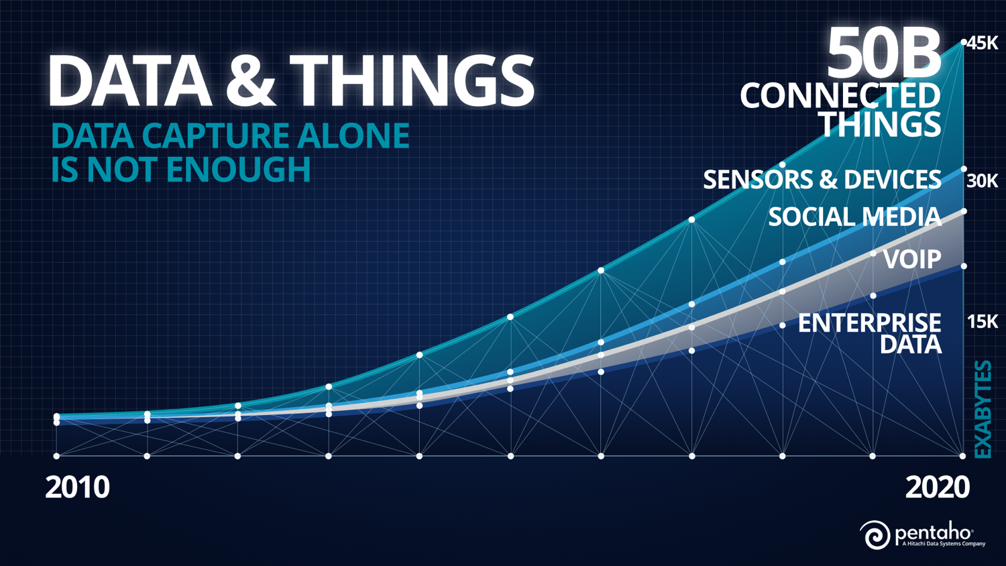
Notes:
SLIDE 2-(data and things graphic)
BY 2020 THE WORLD ECONOMIC FORUM HAD FORECASTED THAT THERE WILL BE MORE THAN 5 BILLION PEOPLE AND 50 BILLION THINGS CONNECTED TO THE INTERNET (THINGS LIKE SMART PHONES, SENSORS, COMPUTERS)
+CISCO ESTIMATED THAT THE INTERNET OF EVERTHING DEVICES WILL GENERATE OVER 400 ZETABYTES OF DATA BY 2018..In context—42 zetabytes includes all the words ever spoken by human beings!!
+HOWEVER CAPTURING AND STORING THIS DATA IS NOT ENOUGH

Slide 10
The most powerful insights come from blending data from multiple sources

Slide 11
Big Data Blueprints Analytics at the Point of Impact

Slide 12








Blending the Worlds Together
Customer
Provisioning
EDW
DATA MARTS
BI TOOLS
Billing

Slide 13














Blending the Worlds Together
Sensors
Web
Network
Location
Social Media
Customer
Provisioning
EDW
DATA MARTS
BI TOOLS
Billing

Slide 14









Blending the Worlds Together
Sensors
Web
Network
Location
Social Media
Customer
Provisioning
EDW
Billing
DATA MARTS

Slide 15











Pentaho Uniquely Positioned
Data Engineering
Data Engineering
Data Preparation
Analytics
Conform
Orchestrate
Build
Cleanse
Transform
Blend
Prepare
Refine
Enrich
Model
Analyze
Ingest
Virtualize
Score
Visualize
Shape
Managing and Automating the Pipeline
Administration
Security
Lifecycle Management
Data Provenance
Dynamic Data Pipeline
Monitoring
Automation
Notes:
With this the END TO END landscape leave only a few that can compete:
I mean, Pentaho covers since Data Ingestion, preparation, transformation, data enrichment, data mining and data visualization and exploration.
This is very unique position
ES
Con este panorama END TO END sólo unos pocos que pueden competir :
Pentaho abarca desde la ingestión de datos , preparación, transformación , enriquecimiento de datos , minería de datos y visualización de datos y la exploración.
Esta es la posición muy singular

Slide 16

Emerging Big Data Use Cases
Drive incremental revenue
Predict customer behavior across all channels
Understand and monetize customer behavior
Begin to monetize data as a service
Improve operational effectiveness
Machines/sensors: predict failures, network attacks
Financial risk management: reduce fraud, increase security
Reduce data warehouse cost
Improve customer experience
Build a 360° view to fully understand and serve the customer
Drive personalized and adjusted interaction
Use automated recommendations logic
Notes:
Companies that take a wait and see attitude with big data will fall behind their competitors with respect to winning, servicing and retaining customers, -CLICK- improving optional effectiveness and reducing costs –CLICK- and growing new streams of revenue through improved customer experience. The big data use cases offer proven methods for creating real value out of big data.

Slide 17







A Spectrum of Big Data Use Cases What the Market is Deploying today and Planning for Tomorrow
Transform
Monetize My Data
Customer 360 Degree View
360 Degree View
Business Impact
Harnessing Machine & Sensor Data
Next Generation Applications
Streamlined Data Refinery
Streamlined Data Refinery
Big Data Predictive Analytics
On-Demand Big Data Blending
Data Warehouse Optimization
Internal Big Data as a Service
Data Warehouse Optimization
Data Warehouse Optimization
Optimize
Filling the Data Lake
Big Data Exploration
Entry
Use Case Complexity
Advanced
Notes:
The spectrum of Big Data Use Cases shows where organizations are investing and reaping benefits from Big Data. Many companies start with data warehouse optimization to reduce costs and improve analytic performance. The streamlined data refinery is often the next step to achieving greater value. The customer 360 focuses squarely on winning with customers. And the Monetize My Data use case helps companies generate new revenue streams and business opportunities from their data.
NOTES ON CUSTOMER EXAMPLES
NetApp: Was not able to meet SLAs on it hardware performance because its device monitoring infrastructure was too slow, and too expensive to scale out. By switching to a Hadoop environment and leveraging Pentaho DI, NetApp was able to save $15M in its first year as a customer
Ruckus Wireless: First, optimized its DW by ingesting large volumes of semi-structured WiFi machine data to analyze. However, Ruckus wanted to pass on their analytics insights in a self-service manor through a custom embedded dashboard made with C+Tools. This requires Ruckus to govern and publish relevant data cubes to its customers, who’s data is streamlined to them in a multi-tennant environment, ensuring data integrity and security.
RichRelevance: {rr} is creating a personalized ominchannel experience, by blending data from stores, loyalty programs, retail product catalogs and semi-structured internet log files. Not only does {rr} share their analytic insights to their users to enhance their view of their customers, {rr} seamlessly recommends product through proprietary predictive algorithms that leverage data from their 2PB data warehouse, uploading content to websites in less than 65ms
Halliburton: Landmark is a subsidy of Halliburton that creates software for the Oil and Gas Sector. They extract GIS, machine data, operational data and logistics data into a Hadoop environment and present these streams of data to their customers through applications with Pentaho embedded within. Landmark has created 12 applications all leveraging Pentaho, in a customize UI, that allows them to monetize data relative to well performance, drill performance, and well management amongst others which also help their end customers improve safety, and maximize revenue.

Slide 18
Cyber Security Analytics

Slide 19

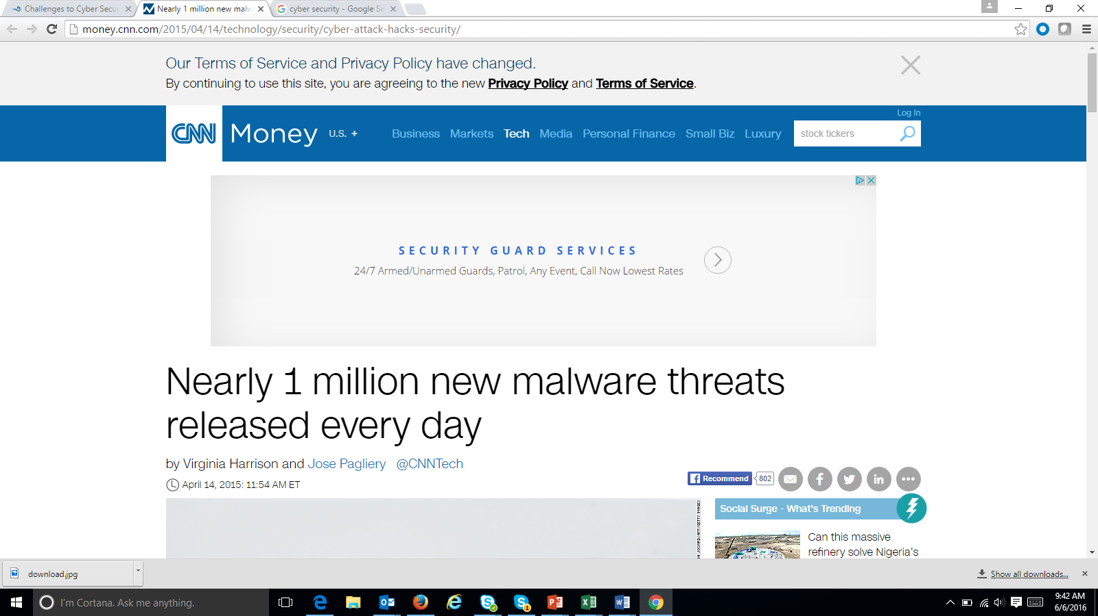
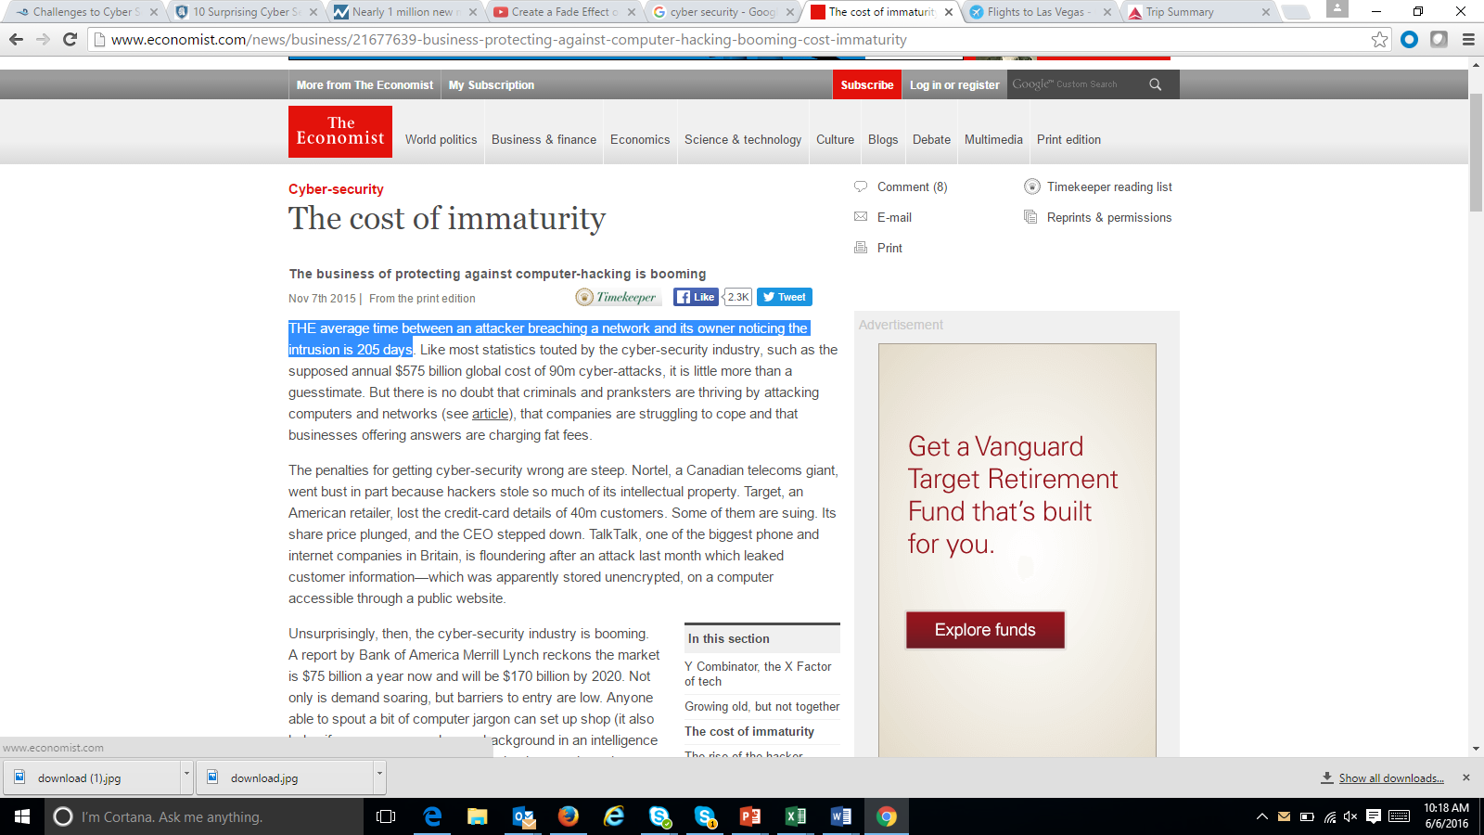
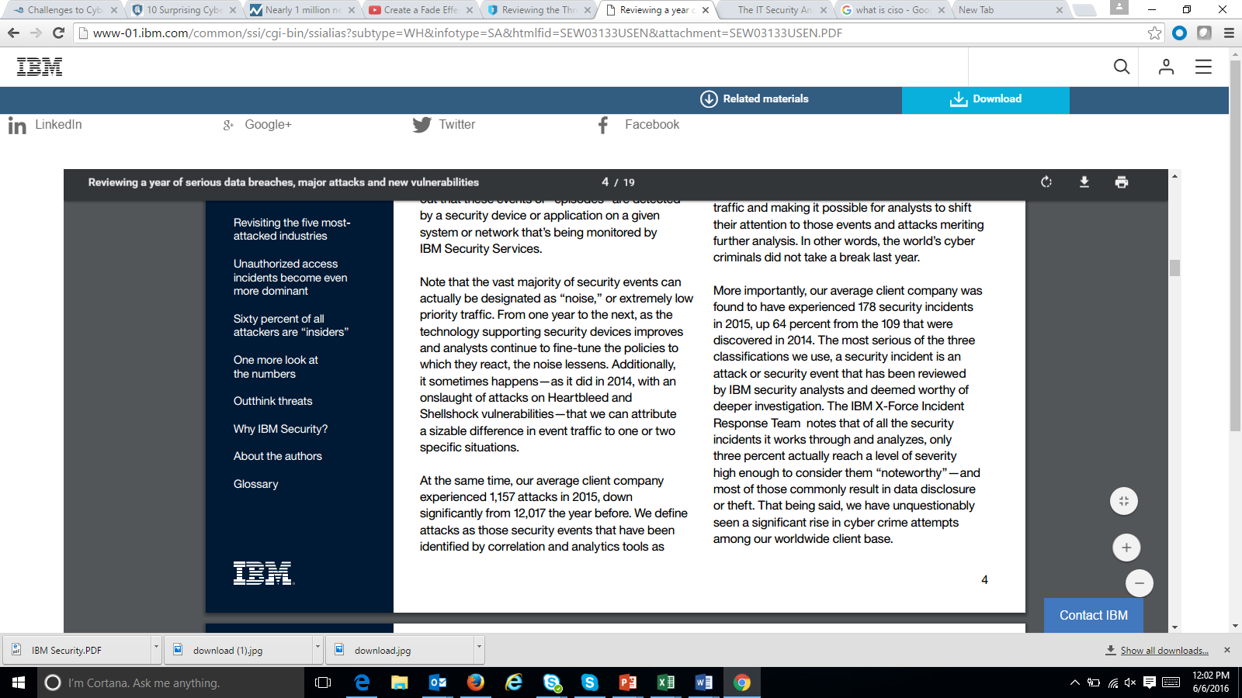
The Challenges of Cyber Attacks
“1 Million New Cyber Threats per Day”
“50% of all the risks faced by an organization were attributable to phishing”
CISO FORUM 2016
“The average time between an attacker breaching a network and its owner noticing the intrusion is 205 days”
45% of most frequent incidents are unauthorized access of which 60% of the attackers are “insiders”
Notes:
The 1 Million New Cyber Threats per Day quote - http://money.cnn.com/2015/04/14/technology/security/cyber-attack-hacks-security/
http://www.economist.com/news/business/21677639-business-protecting-against-computer-hacking-booming-cost-immaturity
https://securityintelligence.com/ciso-forum-2016-what-is-keeping-cisos-awake-at-night/
http://www-01.ibm.com/common/ssi/cgi-bin/ssialias?subtype=WH&infotype=SA&htmlfid=SEW03133USEN&attachment=SEW03133USEN.PDF

Slide 20
The cost of neglecting Cyber Security
Compromised Customer Personal Data
Stolen Corporate Intellectual Property
LOSS REVENUE
Exposed Employees Personal Data
Business Disruption
Loss Customer Base
Loss Opportunities
Notes:
Ecommerce is a $3 Trillion Dollar market and Cyber Security can take 15% to 20% of it. http://www.telegraph.co.uk/technology/internet-security/10886640/Cyber-crime-costs-global-economy-445-bn-annually.html
Sony Playstation network shutdown by LulzSec. Revenue Loss $171 Million (2011)
Citigroup – Hacker exploited a basic online vulnerability and stole account information from 200,000 clients. Because of the hacking, Citigroup said it lost $2.7 million.
Hacker breached into Target’s network and took payment cards, a lost of $141 Million.

Slide 21
Barriers to data security adoption
451 Research – Vormetric 2016 Data Threat Report
Notes:
Data Security
http://enterprise-encryption.vormetric.com/rs/480-LWA-970/images/Vormetric_2016_Data_Threat_Report_Global_WEB.pdf
Next slide will explain complexity in detail

Slide 22
What are some of the complexities?
Draft
Mobile, Cloud, Big Data and IOT
Shortage of Skilled Security Experts
Complexity
More resources required to deploy, operate and maintain
Data Security Products complexity
Today’s threats may not be the same tomorrow
Tasked to do more with less
Notes:
With the adoption of Mobile, Cloud, Big Data and IOT, Cyber attacks can happen at any point of a company’s digital transformation. Vendors offering multiple point tools to solve a specific problem but doesn’t necessarily solves it holistically.
Building a foundation of Cyber Security solution requires more resources to deploy, operate and maintain but Cyber Teams are often under budget and tasked to do more for less.
Data Security Products are complex to deploy and use. A shortage of skilled security experts in the market making it difficult to hold a network fence against cyber intrusion 24/7.
Today’s threats may not be the same tomorrow, therefore, companies need advanced analytics to identify behavioral patterns that leads to predicting cyber attacks.

Slide 23




Cyber Security Through Logs
Draft
A Big Data Problem
# of Log entries per Day
64.8 M Logs
21.6 M Logs
21.6 M Logs
1.4K Logs
4.3K Logs
1 log created every minute
3 different types of logs
Analyze logs from 5K PCs
Analyze logs from 5K mobile devices
Collect logs from 3K machines from 5 data centers
Over 100M logs per day!
Over 21 Billion logs in 205 Days!
Notes:
A log is an accounting record of what happened in a machine or an application through time. It’s one of the better data to analyze cyber intrusion.
Log is a Big Data problem due to the diversity and volume of logs can be recorded in a day. A machine can record a log per minute and can generate 1,440 logs per day. But most company would analyze more than 1 type of log. Sometime 3 applications of logs need to be monitored and that translates to over 4K logs per day.
When the Big Data problem stems from analyzing thousands of PC, thousands of mobile devices and even thousands of machines from 5 different data centers, the volume of logs can be generated from hundreds of millions per day to billions of logs if it takes 205 days to detect cyber intrusion.

Slide 24
Cyber Security – In addition to logs
Draft
Unstructured Data
Source : IDC, The Digital Universe, Dec 2012
Notes:
Log is Semi-Structure because the structure part is only time-stamp, IP address, standards for vlog. But most of it is unstructured. This explains why the unstructured part is growing.
Most Unstructured Data are:
Social Media Data with Personal Credit Card Information
Geo-Location (semi-structured and unstructured) – where is the credit card been used
Emails with attachments and links to bad list of URLs

Slide 25

Challenges with Security Incident and Event Management
Draft
Traditional SIEM
Not designed to handle semi structured and unstructured data.
Not efficient to write new alerts; need programing
Not a hunting tool so it doesn’t do well for behavior intrusion analytics
May need to integrate to other analytics solution
Notes:
Only focus on network logs and not other logs.
Don’t handle semi-structured and unstructured data

Slide 26
Cyber Security
Draft
The Complexity of a Big Data Problem
Internal
Blend Data at Scale
External
Server
Network
Internet
IPR Systems
CRM & ERPS Systems
User Lists
Compromised Websites
Known Phishing Senders
Geo Location
Social Media
In order to do Behavior Intrusion Analysis, you need to blend data at scale to get 360 degree cyber attack view!
Notes:
Next gen cyber security systems – Logs, structured, unstructured semi-structured data from internal and external sources
Ability to scale to petabytes
Blend all data sources at scale and making it ready for correlation across desperate sources.
Ability to setup automated alerts

Slide 27

Why Pentaho Cyber Security Analytics?
Draft
Automate preparation, blending, reporting and alerting of complex variety of data
Fill some of the resource gaps through automation
Integrate predictive analytics for near real time behavioral analytics
Reduces complexity without the deep cost to deploy, maintain and operate.

Slide 28


Blend Logs and Business Data with 360 view - Cyber Security Investigating
LDAP
Automated Onboarding
Sophos
Hadoop Cluster
Data Integration
Analytic DB
Web Logs
PDI in cluster processing
R, Python Weka
Cyber SecurityAnalytics
On-Demand Integration & Blending
Data Integration
Employees or Outsiders
Existing
ETL Tool
or Pentaho
SIEM
Existing ETL Tool or PDI
Data Marts
BI Tools
External WatchList of URL sites
EDW
Notes:
Pentaho automatic Meta Data Injection and support MapReduce allow customer to leverage the data lake using Hadoop or NoSql. The parsing and meta data management is the hardest part of data lake process and Pentaho can automate this process for you
In addition to bringing data to the data lake. It’s also important to take advantage of Advanced Analytics in the process by integrating algorithms in Hadoop to help detect cyber intrusions and potential threats
We can also blend data from SIEM, HCM and External Watchlist for Cyber Security 360 view.

Slide 29
Greatly improve analysis time
Months to Never
Logs, Tweets, CRM, Geo data, etc
Parse Logs & Enrichment
In-line Analytics
Alerting
InteractiveAnalytics
Security & Governance
Reporting
Simplified by Pentaho Cyber Security Analytics
Security & Governance
Automated
Automated
Automated
Automated
Automated
Automated
Hours to Minutes
Notes:
Log ingestion, unstructured, semi-structured and unstructured is just bringing the data from a data source into Pentaho.
Parse Logs is doing meta data injection. Enrich the data is blending data like employee, geo-location, device, etc….
Advanced Analytics is leveraging Weka to do intrusion behavior and anomaly detection.
Once an attack is detect, Pentaho can do real time alerting.
Modeling?
Create reports to communicate Cyber Attack activities and analysis to help with decision.
Decision will create better Security & Governance.

Slide 30

Empower Your Team!
Who can take advantage of the Cyber Security Analytics?
CISO
Cyber Forensic
Cyber Data Analyst
Data Scientist
Notes:
Hadoop is a commodity hardware which requires new skill. We’re allowing your team to use existing skill to work on commodity technology without a huge learning curve. You can triple the productivity of your team. Now your team has more time for the next priority.

Slide 31

Chevron: Using Predictive to Eliminate the Risk of Cybersecurity Threats
Business Case
Security around critical infrastructure and resources is a top priority. Cyber crimes have gone up 20%+ from last year; Northeast Blackout cost an estimated $6 Billion
Challenges
Parsing
Dozens of log formats from many sources: firewall, anti-virus, Active Directory, web proxy, email.
Complex parsing logic using cryptic regular expressions (regex) took days of development for each log format.
Relying on an expensive resource (data scientist) to do operational activities
Threat detection at scale
Benefits
Previous parsing process was replaced with a simple Pentaho workflow using zero code developed in under 1 hour.
Pentaho’s dynamic ETL capabilities provide resilience for changing log formats that would break brittle regex expressions
Pentaho enabled various threat detection algorithms to be operationalized on Hadoop at scale. R and Weka predictive analytics algorithms can also be embedded into Pentaho workflows for more advanced threat detection.
Easy to create transformations made it easy to hand off the implementation process to the data engineering team and freed up the data scientist’s time to focus on the algorithms
Why Pentaho?
Faster time to delivery for ingestion, processing, and analysis of big data
Lowered risk by providing a supported, enterprise-class production platform
Lower total cost of ownership by simplifying both the effort and skillsets required to deliver, enhance, and maintain solutions
Notes:
Links to articles:
http://www.scientificamerican.com/article/2003-blackout-five-years-later/
All told, 50 million people lost power for up to two days in the biggest blackout in North American history. The event contributed to at least 11 deaths and cost an estimated $6 billion.
http://www.dataprotectionreport.com/2015/04/energy-cybersecurity-a-critical-concern-for-the-nation/
Energy infrastructure disruptions – New York City lessons
http://www8.hp.com/us/en/software-solutions/ponemon-cyber-security-report/
It's no surprise—the cost to businesses of cyber crime continues to climb. This new study by the Ponemon Institute shows average annual losses to companies worldwide now exceed $7.7 million, with studied companies losing up to $65 million. But companies are fighting back and using technology and best practices to reduce cyber crime losses. Dig into the reports to learn which defenses are most widely deployed, which are most effective, and which return the most on investment
http://www.forbes.com/sites/michaelkrancer/2015/11/04/the-biggest-cybersecurity-threat-the-energy-sector/#5616d34060ba
According to a Wall Street Journal report, a survey of 625 IT executives in the U.S., U.K., France, and Germany found that 48 percent said they think it is likely there will be a cyber-attack on critical infrastructure, including energy infrastructure, in the next three years that will result in the loss of life. The costs of cybersecurity are also increasing at an alarming rate. For example, JPMorgan Chase’s annual cybersecurity expenditures are expected to double to $500 million within the next five years.
About Chevron:
Chevron has a broad range of business opportunities and challenges which require tools and technologies that leverage data science as well as big data. These range from sales and marketing to cyber-security to oil & gas-specific use cases and many others. We worked with the Chevron big data group who brought in two teams:
Cybersecurity
Chevron Lubricants – not featured here
Chevron’s business case & challenges:
Cyber-security: quickly identify threats using an array of techniques, including machine learning algorithms against big data. For example, vast quantities of network log data must be scanned for suspicious activity such as blacklisted domain names.
Master data management: implement data workflows to validate, cleanse, and match records from diverse systems. Workflows will implement Chevron-specific business rules, natural language processing, and data science to support efficient business processes. This effort will enable the following use case.
360 degree view of sales and marketing: blend data from diverse systems including Salesforce.com, SAP, and other applications to determine the effectiveness of sales and marketing efforts at a granular level. For example, sales that are forecasted in salesforce.com must be compared to actual sales in SAP, while taking into account many other factors such as salesperson activity/behavior, fluctuations in weather, oil prices, social media, and other data sources. This will enable the business to learn what works (and what doesn’t) for driving sales.
Why Pentaho? Both the Cybersecurity team identified significant pain around manual scripting. In fact, one member was wearing a wrist brace that said was from “repetitive stress from weeks for scripting”. The POC proved that Pentaho provided a better way:
Cybersecurity team was impressed that we were able to reproduce days of complex scripting with simple workflows created in a couple hours
Early benefits:
The cybersecurity use case demonstrated reproducing parsing logic that was performed manually via scripts. The manual scripts took several days and we developed a cleaner/simpler parsing workflow in less than 3 hours.

Slide 32
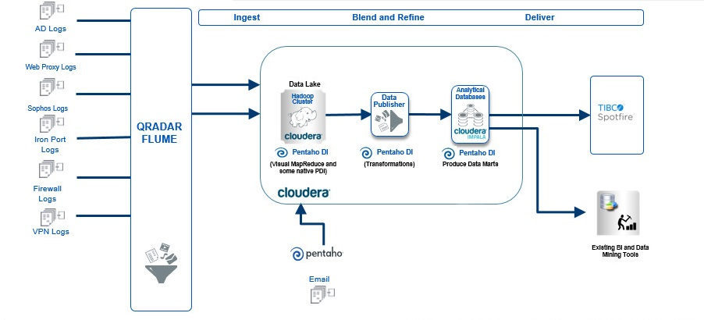
Chevron Architecture Slide

Slide 33
The Solution – semi-structured network log parsing
Semi-structured data such as many log files present challenges not found in row/column-based traditional data.
RowHeader key1=val1 key2=val2 key3=val3 RowHeader key2=val2 key1=val1 RowHeader key1=val1 key3=val3 key2=val2
The example above has 3 issues to address:
The row is comprised of two components at a high level: a RowHeader prefix and a set of key/value pairs.
Not all key/value pairs are in each row
The key/values appear in different order.
In addition, new keys may appear in logs after upgrades. These keys should be automatically detected and processed.
Pentaho has specific features to simplify parsing this type of data dynamically.

Slide 34
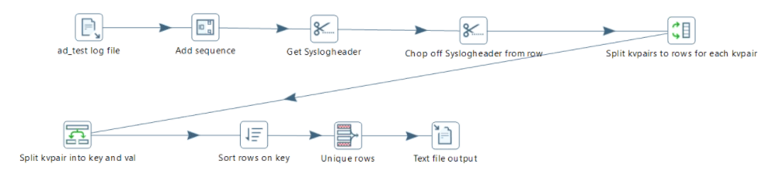
The Solution – dynamic metadata extraction
We developed a generic transformation template to scan for all possible keys in a log file.

Slide 35
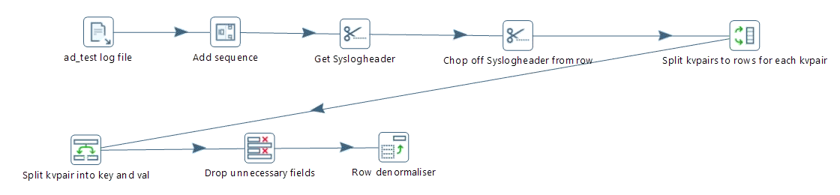
The Solution – log parsing template
We developed a generic transformation template for parsing the logs
The template accepts a list of keys to extract at run-time.
Key/value pairs may vary from row to row
Key/value pairs may appear in any order

Slide 36
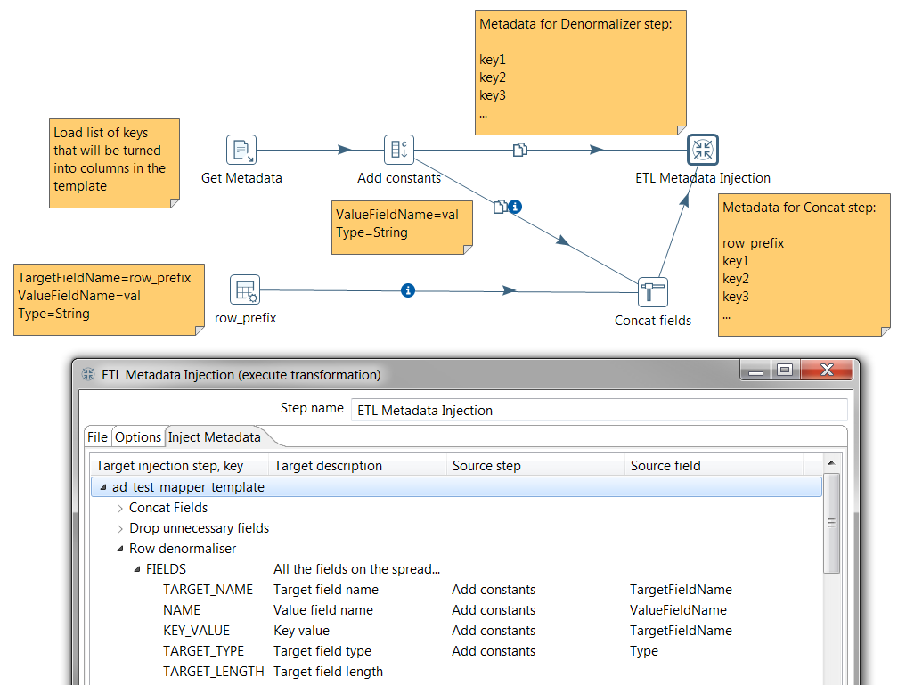
The Solution – ETL metadata injection
Inject metadata into a transformation template at run time.
Multiple metadata lists may be injected into the same template for use at different steps within the template.

Slide 37
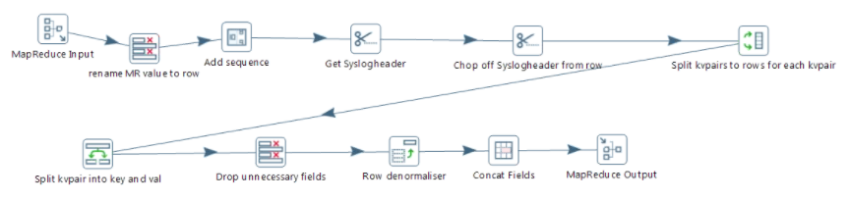
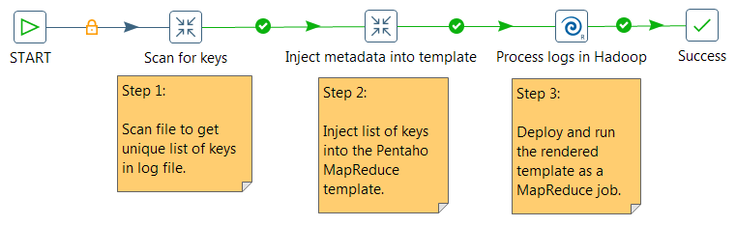
The Solution – Pentaho MapReduce and Job Orchestration
Modifying the transformation to run on Hadoop only required changing the end points. All the logic remained the same.
A simple workflow automates the entire process

Slide 38
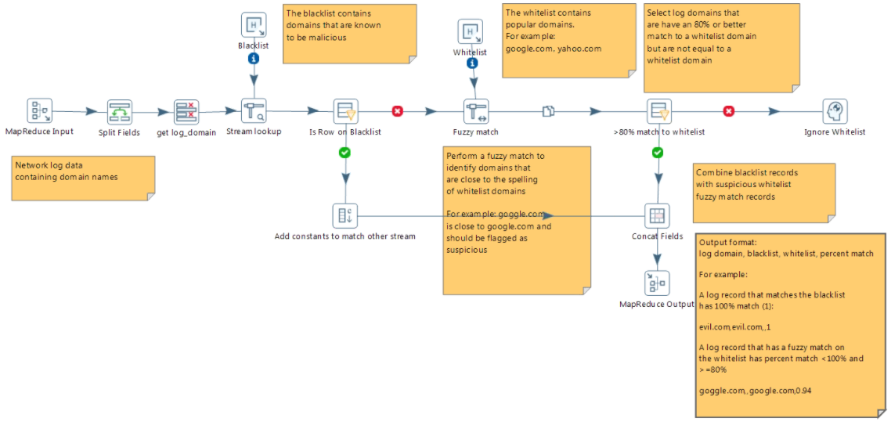
The Solution – Scanning for suspicious domain names
Blacklists exist for known suspicious domain names. However, suspicious activity often comes from domains that are named similarly to legitimate domains. For example goggle.com or yaho.com should be flagged as suspicious.
Processed 21GB of web proxy logs on 4-node Hadoop cluster in under 10 minutes.

Slide 39
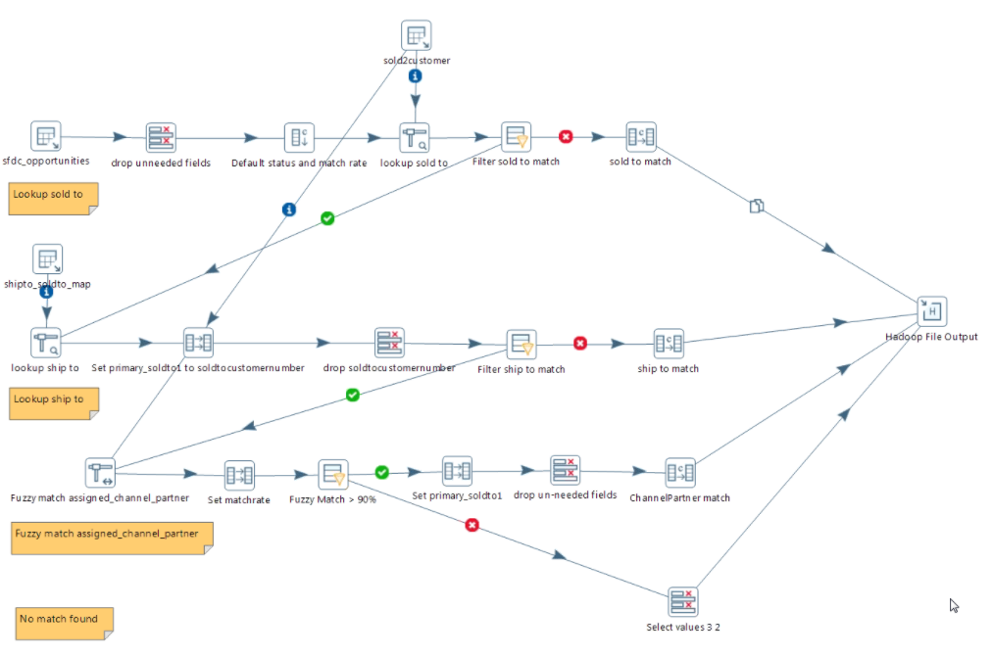
The Solution – Data Validation and Cleansing
Lubricants team quickly ramped up on PDI.
We created a simple workflow with multiple business rules for matching SFDC accounts with SAP in a few hours, reproducing days of manual scripting.

Slide 40
Thank You

